Slide 1
Research Paper Presentation
Influence of Growth Mindset on Mathematics Achievement
Kristin Drew
Masters Candidate
Summer Session
2016

Slide 2
How well did the research answer the question?
?
The research was conducted on a very small sample given a very short lesson on growth mindset. The results were encouraging in that students did respond to the ideas about growth mindset and how to change a fixed mindset statement to a growth mindset one.
Notes:
I was able to survey and work with Joe Madigan’s summer class. The students signed up ( or were signed up by their parents) after their 8th grade year to help prepare them for 9th grade. The sample was only 20 students and they are a “filtered” group- not a true representation of all students.

Slide 3
Results:
GROWTH MINDSET SCORE:
Mean Pre-test: | Mean Post-test:
5.1 | 7.0
http://mindsetonline.com/whatisit/about/
Notes:
Online test given to students from Carol Dweck’s website.

Slide 4
What further research is suggested?
A larger sample.
A problem for students to solve to demonstrate math achievement- given before and after the lesson.
Targeted Growth Mindset lessons over time- the whole semester--one a month?
Notes:
I did give a problem to the students but it was not the same problem both times so the results were not helpful.

Slide 5
What do the results indicate about changes to instruction and learning practices?
Even a short lesson had a positive impact!
Teachers and parents, as well as students, do suffer from fixed mindsets and it is good to check our words and the way we praise students!
Notes:
I understand the basics of Growth Mindset but there are things that I think we all might be able to learn from.

Slide 6
1st Strategy: Praise can lead to a fixed mindset, “Never praise students by telling them that they are smart….when children are told that they are smart they often feel good, but later they fail in some situation-and everyone does-they think, “Hmm, I am not so smart.””
This type of praising leads to a fixed mindset, which is opposite of the growth mindset.
We think we are being helpful but….
Notes:
Other noted strategies: Encourage and praise mistakes- Brain growing exercises! Challenge students with difficult problems!

Slide 7
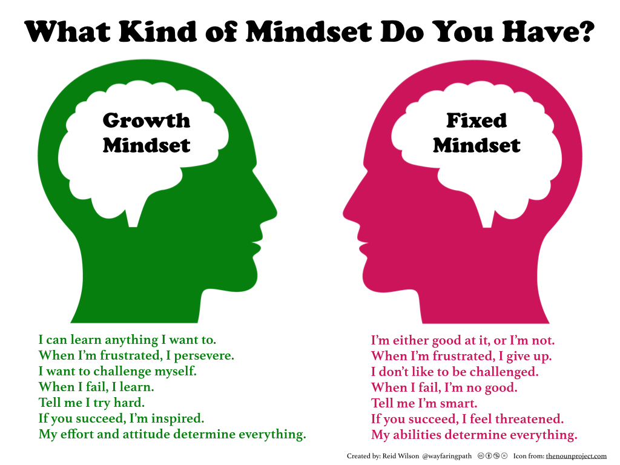
SO…….
Notes:
Remembering to phrase comments to help students grow their brain!

